Slide 1
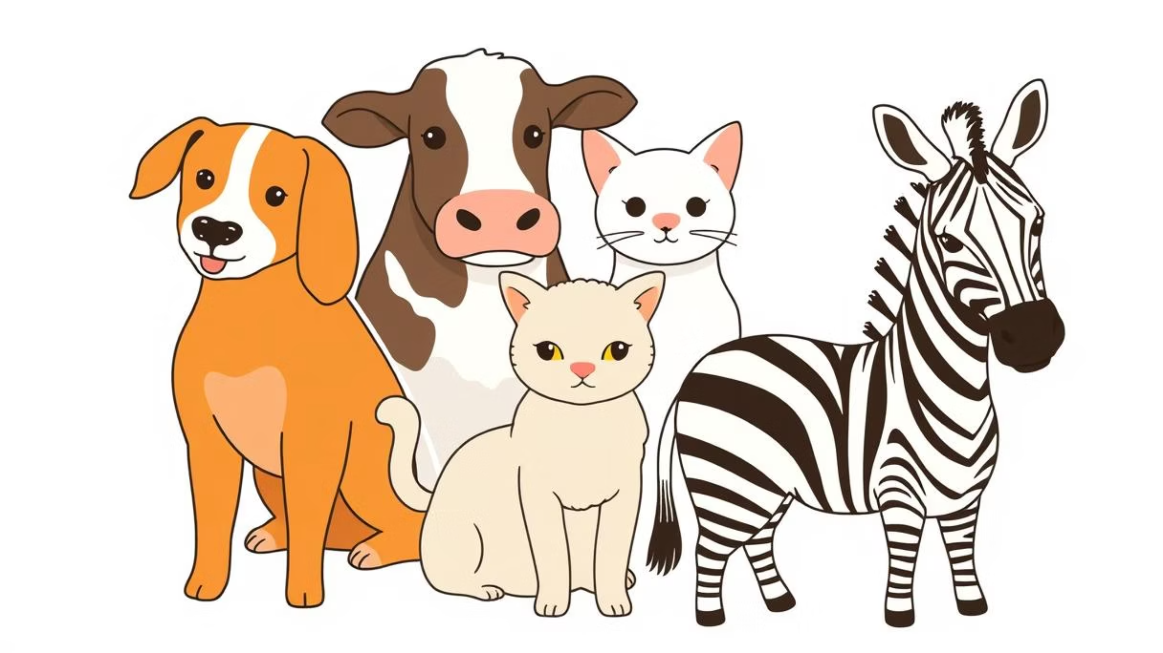
Custom Image Classification Dataset and Model Development for Five Animal Classes
Raisul Islam Kabbo, Md. Rafawat Islam, Shakil Ahmed, Entishar Rashid Chowdhury, Sudipto Roy
Project Group No. 1 | CSE445 - Machine Learning
Department of Electrical and Computer Engineering | North South University, Dhaka, Bangladesh
Group No. 1 Raisul Islam Kabbo, Md. Rafawat Islam, Shakil Ahmed, Entishar Rashid Chowdhury, Sudipto Roy

Slide 2
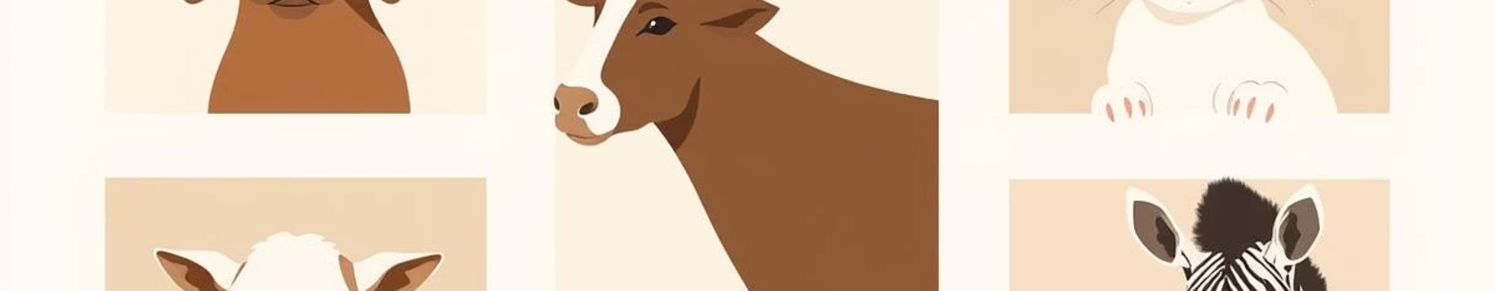

Project Overview: Custom Animal Image Classification
This project focuses on building a custom image classification dataset and training classical machine learning models to classify five animal classes—dog, cow, cat, lamb, and zebra. Each class contains 100 images sourced from the internet and mobile phones.
Dataset Classes
Dataset Size
Dog
100 images per class (500 total)
Cow
Cat
Lamb
Zebra
Preprocessing
Goal
Images resized to 64x64 or 128x128, converted to grayscale or RGB as needed.
Achieve at least 90% accuracy using classical ML models.
Group No. 1 Raisul Islam Kabbo, Md. Rafawat Islam, Shakil Ahmed, Entishar Rashid Chowdhury, Sudipto Roy

Slide 3
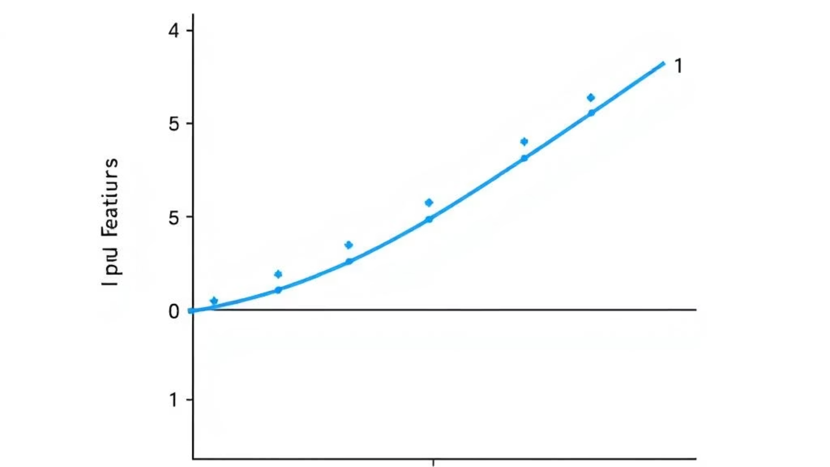
Logistic Regression
The goal was to develop an animal classification system for five species (dogs, cows, cats, lambs, zebras) aiming for >90% accuracy using an optimized Logistic Regression model.
1
2
3
Methodology
Performance & Results
Conclusion
Data augmentation (10x original size).
Validation Accuracy: 84.06%
Achieved 82.83% accuracy, falling short of the 90% target. Suitable for automated animal identification, wildlife monitoring, and educational platforms.
Test Accuracy: 82.83%
Advanced feature engineering (400+ features).
Cats: Highest performance (F1-Score: 97.29%).
ML pipeline with normalization, feature selection, and interaction.
Zebras: Strong performance (F1-Score: 83.61%).
Hyperparameter optimization via GridSearchCV.
Cows, Dogs, Lambs: Moderate (F1-Scores 75-81%).
Model calibration.
Group No. 1 Raisul Islam Kabbo, Md. Rafawat Islam, Shakil Ahmed, Entishar Rashid Chowdhury, Sudipto Roy

Slide 4

Hybrid Approach: Multi-Model Ensemble
This project aimed to achieve over 90% accuracy in animal classification by combining multiple individual classifiers into a Voting Classifier ensemble.
Methodology
Challenges & Solutions
Extensive data preprocessing & augmentation.
Dataset imbalance: Addressed by data augmentation.
Multi-model strategy: LR, RF, SVM, KNN, GB.
Overfitting: Mitigated by cross-validation.
Voting Classifier ensemble.
Noise/complexity: Reduced by careful feature selection.
Feature engineering: PCA, SelectKBest.
Results & Conclusion
Ensemble achieved more stable and higher accuracy, boosting precision, recall, and F1-score. Future work includes larger datasets, hyperparameter tuning, and deep learning.
Group No. 1 Raisul Islam Kabbo, Md. Rafawat Islam, Shakil Ahmed, Entishar Rashid Chowdhury, Sudipto Roy

Slide 5

Random Forest & Ridge Classifier
Random Forest
Ridge Classifier
Selected to overcome overfitting in single decision trees, providing a robust, generalized model.
Chosen for L2 regularization to prevent overfitting and its efficiency with linearly separable features.
Implementation: HOG and PCA feature extraction, 80/20 train/test split, 100 decision trees.
Implementation: HOG and PCA feature extraction, 80/20 train/test split, alpha tuning.
Challenges: Underfitting with PCA (loss of critical information) and HOG (reduced feature space), slow PCA extraction.
Challenges: Underfitting due to linearity, spatial information loss with PCA, over-regularization.
Solutions: Increased image resolution (64x64 to 128x128) improved PCA accuracy (36.75%→44.34%), hyperparameter tuning of alpha (HOG: 64.48%→65.09%).
Solutions: Increased image resolution (64x64 to 128x128) improved accuracy (PCA: 37.16%→46.23%, HOG: 58.13%→65.09%), hyperparameter tuning.
Group No. 1 Raisul Islam Kabbo, Md. Rafawat Islam, Shakil Ahmed, Entishar Rashid Chowdhury, Sudipto Roy

Slide 6

Hybrid Model: Random Forest & Ridge Classifier
This hybrid approach combines the strengths of Random Forest (non-linear relationships, ensembling) and Ridge Classifier (stability, L2 regularization) using majority voting for enhanced reliability and accuracy.
Implementation
Challenges
Solutions & Improvements
Images resized to 128x128, grayscale.
Inconsistent performance based on feature set.
Balanced feature extraction with larger images.
HOG feature extraction (8x8 cells, 2x2 blocks).
80/20 train/test split.
High intra-class variation.
Hyperparameter tuning for both models.
Both models trained simultaneously.
Effective voting mechanism.
Accuracy Boost: The hybrid model achieved 63.21% accuracy, a notable improvement over standalone Random Forest (59.43%).
Group No. 1 Raisul Islam Kabbo, Md. Rafawat Islam, Shakil Ahmed, Entishar Rashid Chowdhury, Sudipto Roy

Slide 7
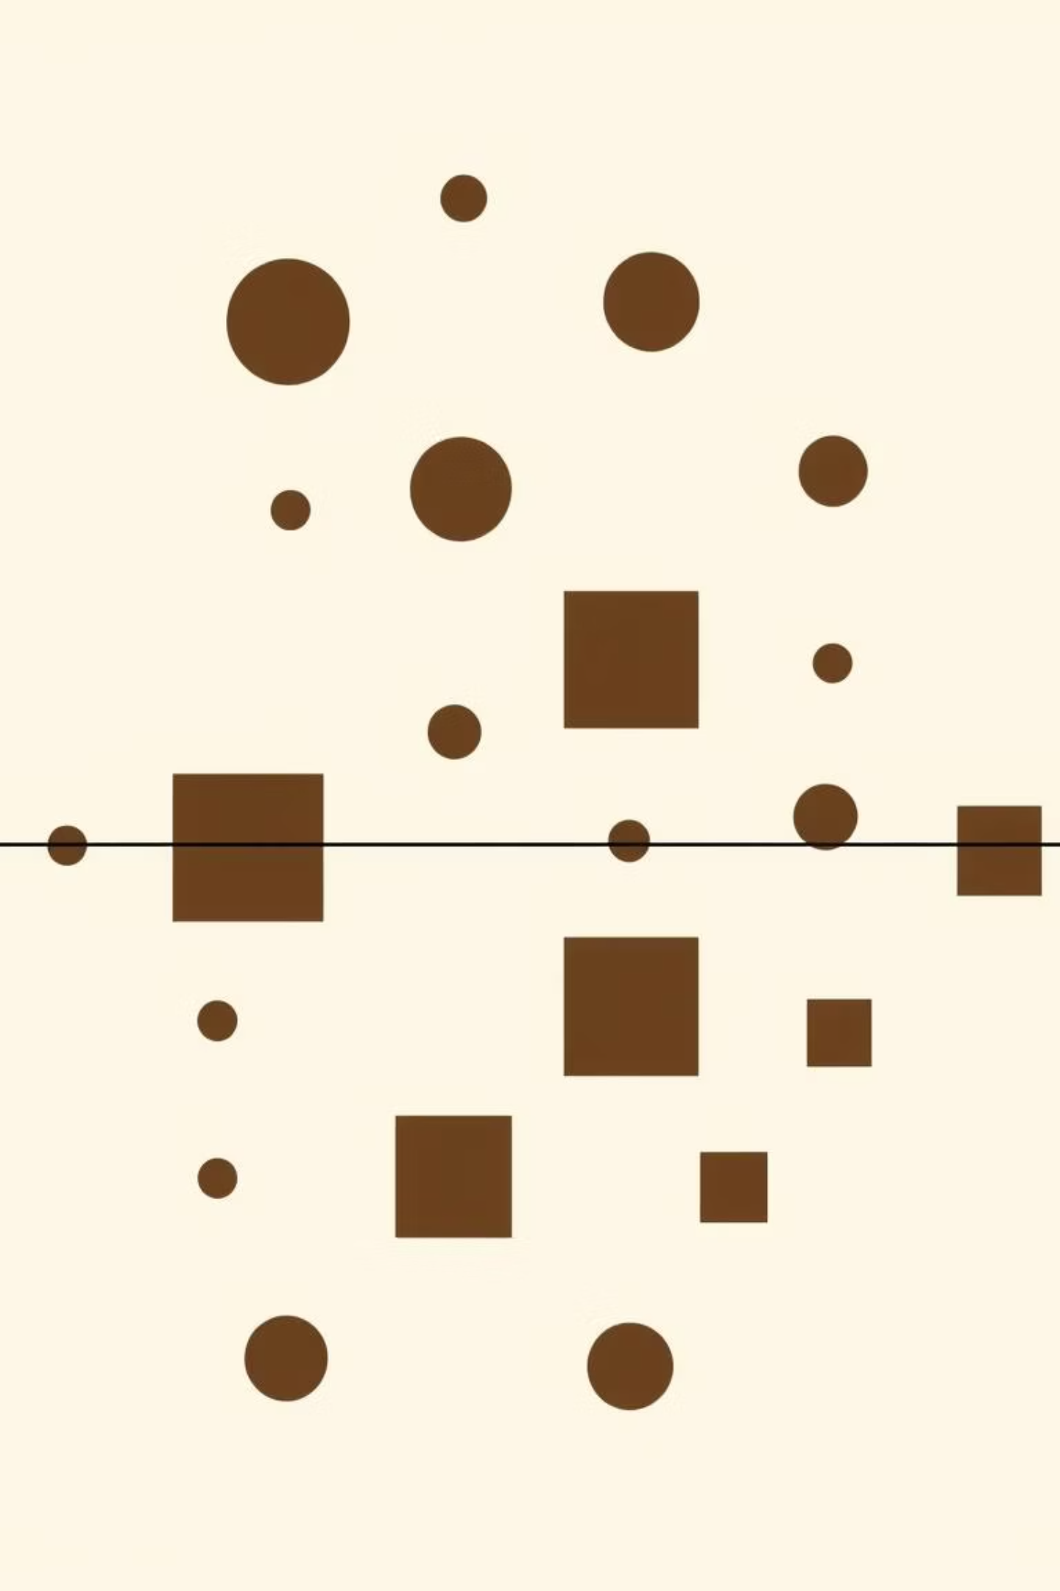
Support Vector Machine (SVM)
SVM was chosen for its robustness, effectiveness with high-dimensional data, and ability to handle non-linearity via kernels, making it suitable for image classification.
Implementation Steps
Challenges Encountered
HOG feature extraction.
Dataset errors (empty folders, mismatches).
80/20 train/test split.
Linear and RBF kernels tested.
Low initial accuracy due to noise and intra-class variation.
Evaluation with accuracy, confusion matrix, and classification report.
Risk of overfitting.
Solutions & Improvements: Data integrity checks, enhanced preprocessing (uniform resizing, normalization, optimized HOG), and prevention of overfitting through cross-validation and hyperparameter tuning (C and gamma parameters).
Group No. 1 Raisul Islam Kabbo, Md. Rafawat Islam, Shakil Ahmed, Entishar Rashid Chowdhury, Sudipto Roy

Slide 8
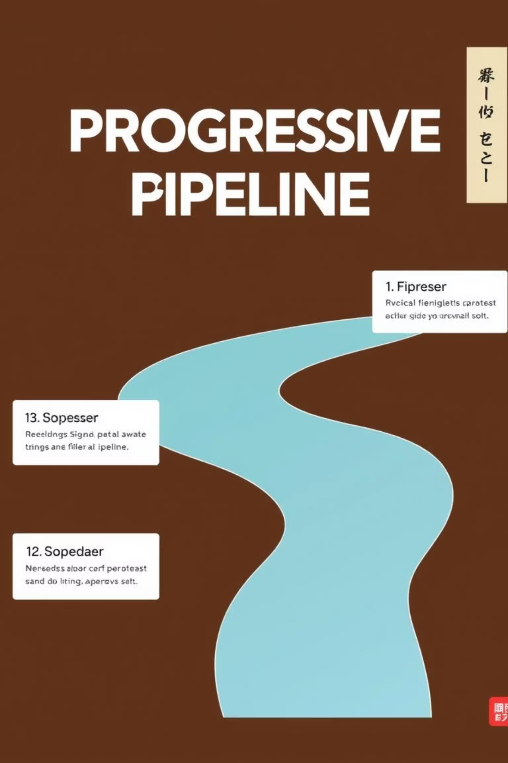
Hybrid ML Approaches: Progressive Improvement
This project explored a progressive pipeline of models for animal image classification, aiming for higher accuracy by integrating advanced techniques.
Stage 1: Baseline (Decision Tree)
Simple, interpretable benchmark. Limited performance due to overfitting.
Stage 2: Improved (XGBoost)
More robust tree-based ensemble. Significant accuracy improvement.
Stage 3: Hybrid Deep Feature Extraction
VGG16 + XGBoost: High-level features from VGG16 improved accuracy.
VGG16 + SVM (RBF Kernel): Further boosted performance with non-linear classification.
Final Insight: Deep features from VGG16 dramatically improved model performance, with VGG16 + SVM-RBF yielding the best accuracy and generalization.
Group No. 1 Raisul Islam Kabbo, Md. Rafawat Islam, Shakil Ahmed, Entishar Rashid Chowdhury, Sudipto Roy

Slide 9

K-Nearest Neighbors (KNN)
KNN was selected for its simplicity and interpretability, serving as a baseline to demonstrate the impact of preprocessing and feature extraction on classification performance.
Implementation Stages
Challenges & Solutions
Baseline (raw pixels)
Low Accuracy: Raw pixels, PCA, and histograms initially yielded poor results.
PCA on RGB
Histogram features
Overfitting: Small dataset and high intra-class variability.
Custom pipeline (histograms, augmentation, manual PCA/KNN)
Sensitivity: KNN sensitive to irrelevant features and unnormalized data.
Optimized pipeline (standardization, optimal PCA, tuned k)
Solutions: Advanced feature engineering, data augmentation, normalization, and hyperparameter optimization.
Final Takeaway: Combining data augmentation with optimal PCA variance and a tuned k value significantly elevated performance to ~93% accuracy from an initial ~36%.
Group No. 1 Raisul Islam Kabbo, Md. Rafawat Islam, Shakil Ahmed, Entishar Rashid Chowdhury, Sudipto Roy

Slide 10

Naïve Bayes & Advanced Hybrid Model
Naïve Bayes
Chosen for probabilistic simplicity and as a fast baseline for high-dimensional data.
Challenges: Violation of independence assumption, curse of dimensionality, information loss from grayscale conversion, data scarcity.
Solutions: Dimensionality reduction (PCA, SIFT), more appropriate models (k-NN, SVM, CNNs), preserving color, data augmentation.
Group No. 1 Raisul Islam Kabbo, Md. Rafawat Islam, Shakil Ahmed, Entishar Rashid Chowdhury, Sudipto Roy

Slide 11

Advanced Hybrid Model
Combines deep feature extraction (ResNet50, EfficientNet-B0, ViT-B/16), dimensionality reduction (PCA, Autoencoders, UMAP), classical ML classifiers, and ensemble methods (Voting, Stacking).
Challenges: Overfitting, feature mismatch, class imbalance, pipeline complexity, hyperparameter sensitivity.
Solutions: Data augmentation, balancing dataset, simplifying pipeline, hyperparameter tuning, regularization.
Group No. 1 Raisul Islam Kabbo, Md. Rafawat Islam, Shakil Ahmed, Entishar Rashid Chowdhury, Sudipto Roy

Slide 12
Key Learnings & Future Directions
Throughout this project, we explored various machine learning models and hybrid approaches for animal image classification, observing significant improvements with each iteration.
Iterative Improvement
Data & Feature Engineering
Hybrid Strength
Progressive application of advanced techniques, from baseline models to complex ensembles and deep feature extraction, consistently boosted accuracy and robustness.
The critical role of extensive data augmentation, careful preprocessing, and sophisticated feature engineering proved essential for overcoming challenges and optimizing performance.
Combining strengths of different models through hybrid architectures and ensemble methods yielded superior results, highlighting the power of multi-faceted approaches.
Next Steps
Future work includes expanding the dataset, exploring more advanced deep learning architectures, and deploying the best performing model for real-world applications. Thank you.
Group No. 1 Raisul Islam Kabbo, Md. Rafawat Islam, Shakil Ahmed, Entishar Rashid Chowdhury, Sudipto Roy

Slide 13
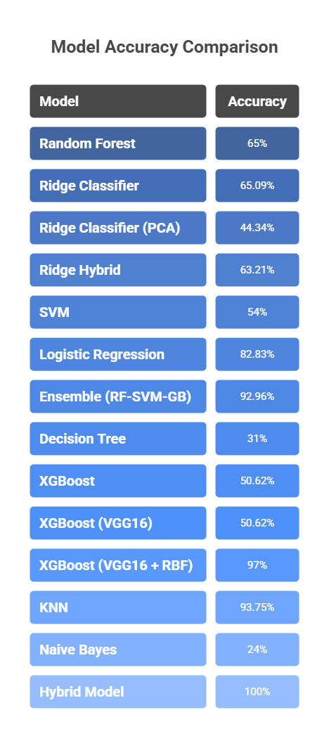

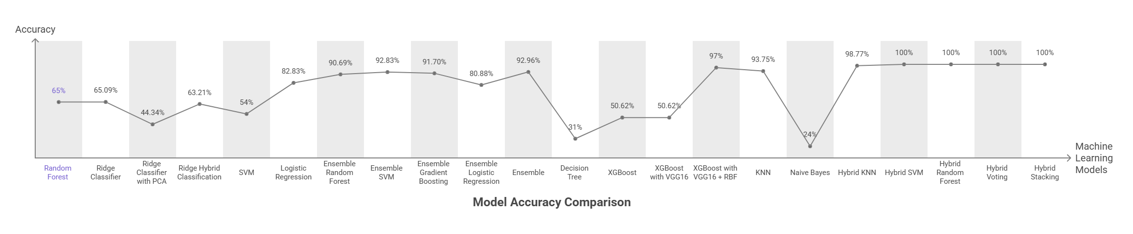

Thank You
Group No. 1 Raisul Islam Kabbo, Md. Rafawat Islam, Shakil Ahmed, Entishar Rashid Chowdhury, Sudipto Roy

